Slide 1
Automated Testbench Creation and Self-Adjusting Tests
By: Ted Humpal

Slide 2
About Me
University of Wisconsin – Madison
BS, Computer Engineering
Acknowledgements:
  Vishal Anand
  Kyle Piper
  Prakash Shroff

Slide 3
Project Goals
Automate the creation of a system verilog test bench.
Dynamically change stimulus distributions to maximize functional coverage.

Slide 4
Automating Testbench Creation

Slide 5
Automation Features
Test
Instantiates and/or creates:
  Testbench
  DUT
  Bus model
  Reference model
  Monitor
  Test
Supports interfaces
Creates clock generators
Initializes resets
Sets up common simulation options
  Random seeds
  Wave dumps
  Log files
TB
Reference model
Monitor /
Scoreboard
Bus model
DUT
Bus model
Notes:
+ tenet: ‘A good sysadmin is a lazy sysadmin’

Slide 6
Automation Features (cont…)
Bus parity signals
  Find interface bus parity signals
  Find the associated bus signals
  Drive the parity signal
  Fire an occasional error
Memory parity fault injection
  Next slide

Slide 7
Memory Parity Injection Tasks
Create internal memory parity fault
Test
Testbench
Reference model
Monitor /
Scoreboard
Parity Injection
Bus model
DUT
Bus model
FIFO

Slide 8
Memory Parity Fault Injection
XPP had 7 parity related bugs that required ECO’s, 2 that were not fixed.
DV checks parity by statically enabling it and has no or limited ability to predict outcomes.
Injecting parity errors enables random testing of all aspects of a design.
Notes:
We have had a number of parity errors in XPP, some required ECO’s some were labeled as no fix. The problem with our parity testing is:
DV checks parity by statically enabling bad parity which results in all writes being written with bad parity. DV has no/limited ability to predict the value of the parity error log registers. In addition to these limitations the tests are assuming that only the parity bit is flipped while the rest of the data fields are correct.
XPP had 7 parity related bugs that required ECO’s, in addition we have 2 pairty bugs that were not fixed.
This DV methodology attempts to plug this hole by automating random injection of parity errors on any bit in the memory. Adding this support in the random tests also allows precise reference model predictions of how the DUT should behave on these errors, as well as the contents of the parity log registers.
Adding ability to inject parity errors also enables a random test to test all aspects of a design, enhancing its value.
You can show the format of the script where we specify the path of the parity path & the corresponding log register. Also mention that a single transaction at the input can result in multiple writes to a memory, and so the parity task handles that as well.

Slide 9
Example File
Creating the parity injection tasks requires a list of registers to inject.
<Name> <Index> <Path>
cellFifoPrtyErrLog 0 XppRec1Port_u0.XppRecFifo_U0
cellFifoPrtyErrLog 1 XppRec1Port_u1.XppRecFifo_U0
cellFifoPrtyErrLog 2 XppRec1Port_u2.XppRecFifo_U0
cellFifoPrtyErrLog 3 XppRec1Port_u3.XppRecFifo_U0

Slide 10
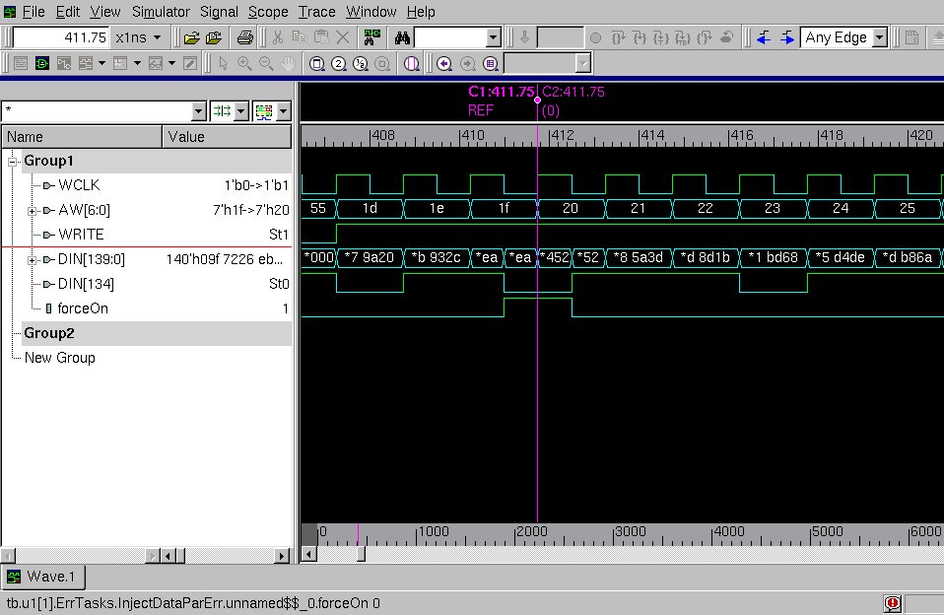

Slide 11
Automation Markers
//AUTOMATION MARKER - BEGIN DECLARATION
module tb();
bit resetAsync = 1;
bit sysClk;
bit txClk;
bit tstClk;
bit ph1;
bit stpClk;
…
//AUTOMATION MARKER - END DECLARATION
…
//AUTOMATION MARKER - BEGIN CLOCKS
int sysClkperiod;
initial begin
if ( !$value$plusargs ("sysclkperiod=%0d", sysClkperiod) )
forever #750 sysClk = !sysClk;
else
forever #(sysClkperiod/2) sysClk = !sysClk;
end
//AUTOMATION MARKER - END CLOCKS
…

Slide 12
Benefits
All the bonuses of automation
  speed, accuracy, no connection errors
Uniformity in testing across components
  Easier to understand
  Important for worker switches and collaboration
Useful for all stages of module design
  Small, low level modules
  Large, high level modules
Sudden change to a design, rerun the script

Slide 13
Future
Automation becomes more powerful with more advanced naming conventions.
Generating system verilog code, how far can it be taken?
Notes:
Adding levels of abstraction is much easier!

Slide 14
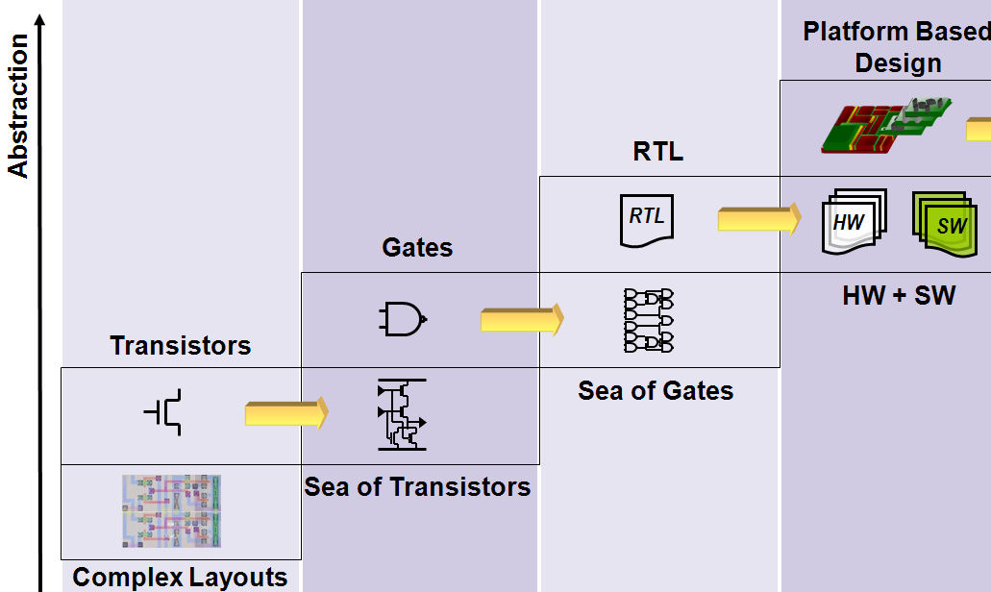
Future Levels of Abstraction

Slide 15
Parity Injection Tasks Revisited
<Name> <Index> <Path>
cellFifoPrtyErrLog 0 XppRec1Port_u0.XppRecFifo_U0_INJ
cellFifoPrtyErrLog 1 XppRec1Port_u1.XppRecFifo_U0_INJ
cellFifoPrtyErrLog 2 XppRec1Port_u2.XppRecFifo_U0_INJ
cellFifoPrtyErrLog 3 XppRec1Port_u3.XppRecFifo_U0_INJ

Slide 16
Python Development
Distributed vs Centralized
Advanced customization
  Create user options to allow insertion of functions into the script.

Slide 17
Introduction to Constrained Random Testing

Slide 18
Constrained Random Testing
Randomized stimuli
  Packets
Constraints
  if (pktType == VLAN) → data[23:8] = 16’h3234
Distributions
  Packet types: VLAN = 50, Unicast = 10, …
Functional coverage
  Have all packet types been tested? Did the test send three VLAN packets in row?

Slide 19
Project Effects
Larger initial setup time
Less overall time
Better bug finding
New problem: How to measure coverage?

Slide 20
Self-Adjusting Tests

Slide 21
Functional Coverage
Purpose: Collect testbench stimulus to determine what was tested
Framework
  Covergroup – a group of coverpoints
  Coverpoint – concerns a signal
  Bins – specified values of that signal
  Cross – looks across multiple
  coverpoints
  Sampling – when to collect data
  .get_coverage() – returns
  percentage covered
Cover Group - CovName
Coverpoint - Length
64
128-255
65 - 127
256
128
…
Coverpoint - PktType
vlan
schidle
custom
schexp
control
twoq
Cover Group - CovName
Cross – Length x PktType
64
vlan
custom
control
schidle
schexpt
…
65 - 127
vlan
custom
control
schidle
schexpt
…
128
vlan
custom
control
schidle
schexpt
…
…
vlan
custom
control
schidle
…

Slide 22
Ideal Example
Cover Group - CovName
Covergroup CovPacket;
mylengths: coverpoint length { bins border1_0 = {64};
bins border2_0 = {65};
bins range_0 = {[66:126]};
…
}
…
mypktTypes: coverpoint pktType { bins pktType_0 = {VLAN};
bins pktType_1 = {CUSTOM};
bins pktType_2 = {CONTROL};
…
}
…
name: cross mylengths, mypktTypes;
…
endgroup
Coverpoint - Length
64
128-255
65 - 127
256
128
…
Coverpoint - PktType
vlan
schidle
custom
schexp
control
twoq
Cover Group - CovName
Cross – Length x PktType
64
vlan
custom
control
schidle
schexpt
…
65 - 127
vlan
custom
control
schidle
schexpt
…
128
vlan
custom
control
schidle
schexpt
…
…
vlan
custom
control
schidle
…

Slide 23
Supported Example
Covergroup CovPacket;
border1_0: coverpoint length { bins border1_0 = {64}; }
border2_0: coverpoint length { bins border2_0 = {65}; }
range_0: coverpoint length { bins range_0 = {[66:126]}; }
…
pborder1_0: coverpoint prevlength { bins pborder1_0 = {64}; }
…
pktType_0: coverpoint pktType { bins pktType_0 = {VLAN}; }
prevpktType_9: coverpoint prevpktType { bins prevpktType_9 = {PAUSE}; }
…
border1_0Xpborder1_0: cross border1_0, pborder1_0;
…
pktType_8XprevpktType_5: cross pktType_8, prevpktType_5;
…
endgroup

Slide 24
Feedback loop
Dynamically alter distribution constraints to complete larger functional coverage.
Test
Original Packet Class
New Packet Class
Functional Coverage
Testbench
Reference model
Monitor /
Scoreboard
Bus model
DUT
Bus model

Slide 25
Framework
Describe coverage and crosses in python, python does the rest
mylengths1 = [64,128,256,512,1024,2048,4096,9216]
[create desired lengths to monitor]
v1 = var_num("length", lengths, "border", "border", constraint_name = "pkt_size")
v2 = var_num("prevlength", lengths, "pborder", "border", "int", cycle=2, prev_member="length")
v3 = var_enum("pktType", range(12), "pktType")
v4 = var_enum("prevpktType", range(12), "pktType", "PktTypeTb", cycle=2, prev_member="pktType")
CreateCrosses(v1, [v2, v3])
CreateCrosses(v3, [v4])
FeedbackCoverpointCoverage([v1, v3], cover_group_name)
FeedbackCrossNowXNow(v1, v3, cover_group_name)
FeedbackCrossNowXPrev(v1, v2, cover_group_name)
FeedbackCrossNowXPrev(v3, v4, cover_group_name)

Slide 26
Framework (cont…)
Contained in a packet class (extended from the original class)
  Feedback is executed in the pre_randomize function Sampling is done in the post_randomize function
  CovGroup.CovPoint.get_coverage()
  $get_coverage(CovGroup.CovPoint) (Buggy)
function void pre_randomize();
If (this.isfeedback == 1) begin
[all distributions reset to 1]
if ((this.CovPacket.border1_0.get_coverage() < 100) && (this.try_counter[0] > 0)) begin
this.w8_border1[0] = 1000000;
this.try_counter[0]--;
end
if ((this.Covergroup.coverpoint.get_coverage() < 100) && (this.try_counter[i] > 0)) begin
this.w8_coverpoint[i] = 1000000;
this.try_counter[i]--;
end
…
end
endfunction

Slide 27
Functional Coverage Case Study: Packet Generation
Packet lengths
  powers of 2
  powers of 2 +/- 1
  ranges in between
Packet types (12 types)
Crosses
  length cross type
  length cross previous length
  type cross previous type

Slide 28
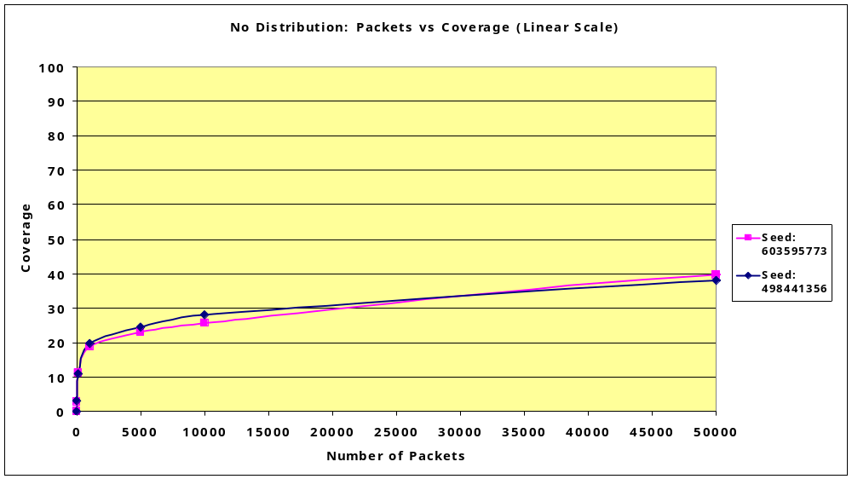

Slide 29
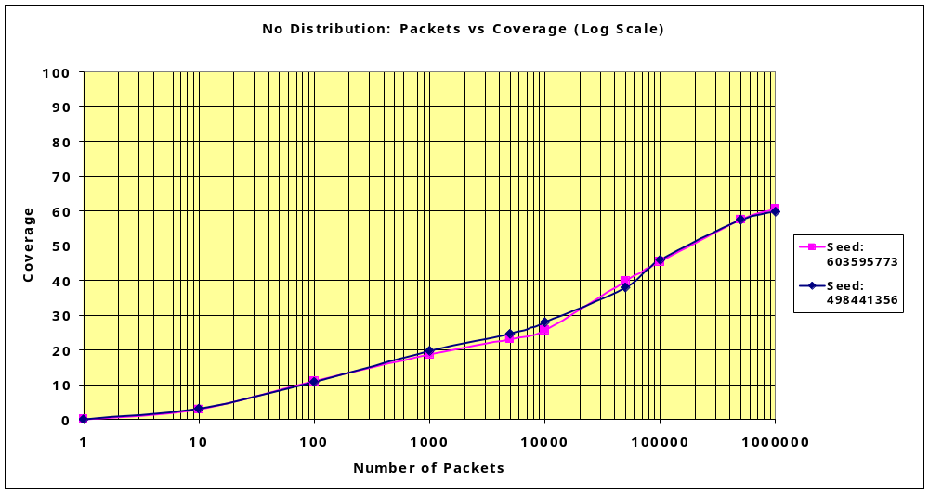

Slide 30
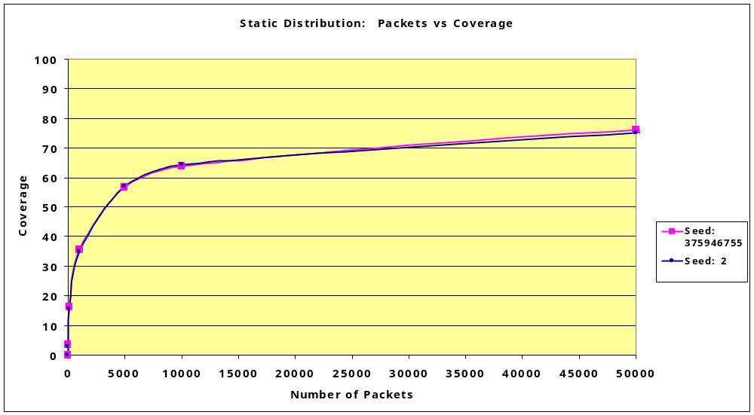

Slide 31
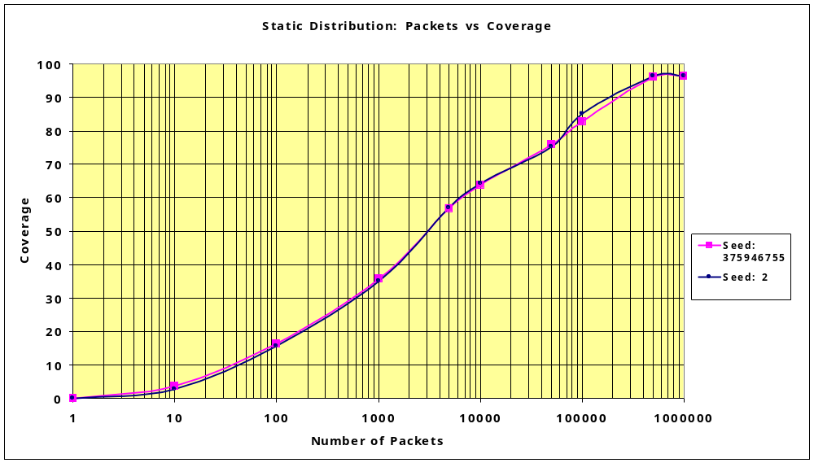

Slide 32
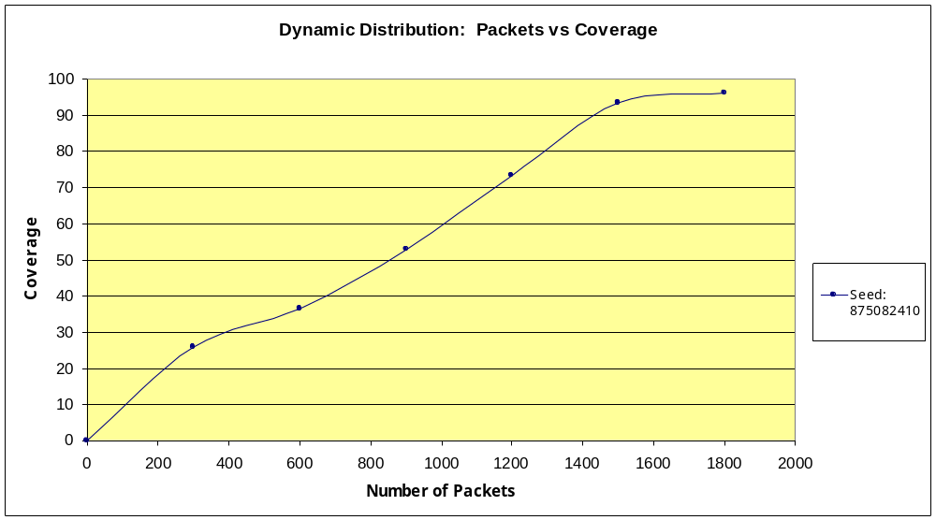

Slide 33
Methodology
One of the first regression tests to run would be dynamic coverage only (cover everything lightly first).
In later stages, use to hit corner cases.
In reference to development stages this would be useful to implement after there is some maturity to the design.

Slide 34
Future
Advanced feedback loops
  Use the bin property .atleast()
More automation - fire and forget
Different kinds of coverage

Slide 35
Python Development
Improve framework
  More classes
  More feedback types
  Tools for more specific and advanced coverage
Class Coverpoint
Present
Future
Class Covergroup
Class Coverpoint
Class Bin
Class Bin
Class Bin
Class Bin
Class Bin
Class Bin

Slide 36
Questions

